Slide 1


„We monitor your
Bridges, buildings, and
Constructions even if
You sleep.”

Slide 2


Problem: why is it important?
Aging structures
Climate change and extreme weather
Increasing usage intensity (such as traffic volume)

Slide 3

Solution:
Long-term monitoring of structures around the clock,
even in hard-toreach areas, using modern online technologies
Collection of data on temporal developments and immediate
notification in case of sudden/significant changes in the structure
Processed data into information to simplify decision-making
Comprehensive system, economically justifiable

Slide 4
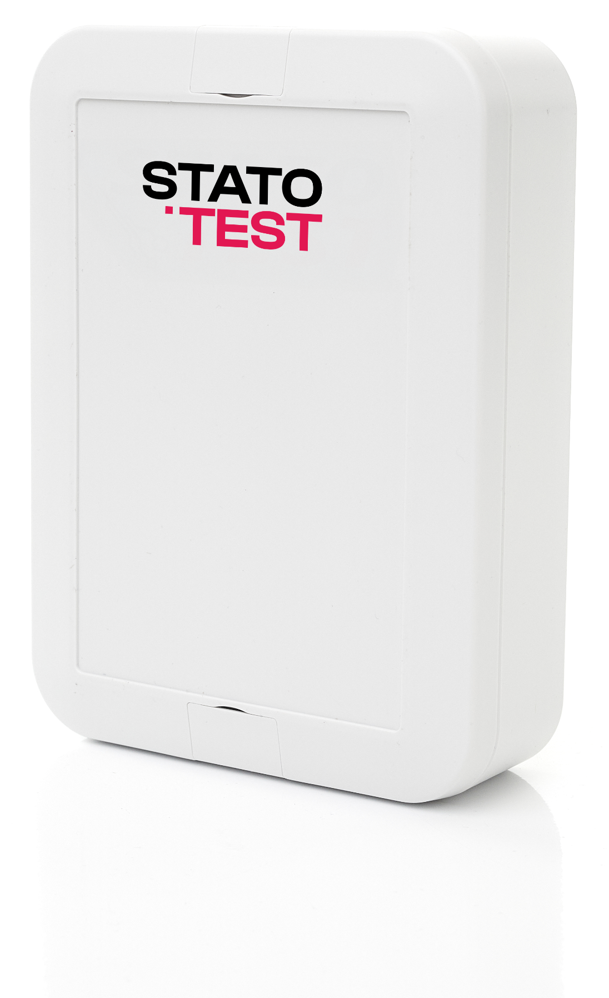
Core concept
of the Statotest
system
The system consists of sensors
developed by us, connection, and
cloud software (using AI tools)

Slide 5
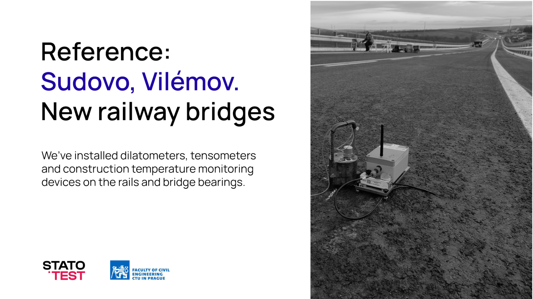
Reference:
Sudovo, Vilémov.
New railway bridges
We’ve installed dilatometers, tensometers
and construction temperature monitoring
devices on the rails and bridge bearings.

Slide 6
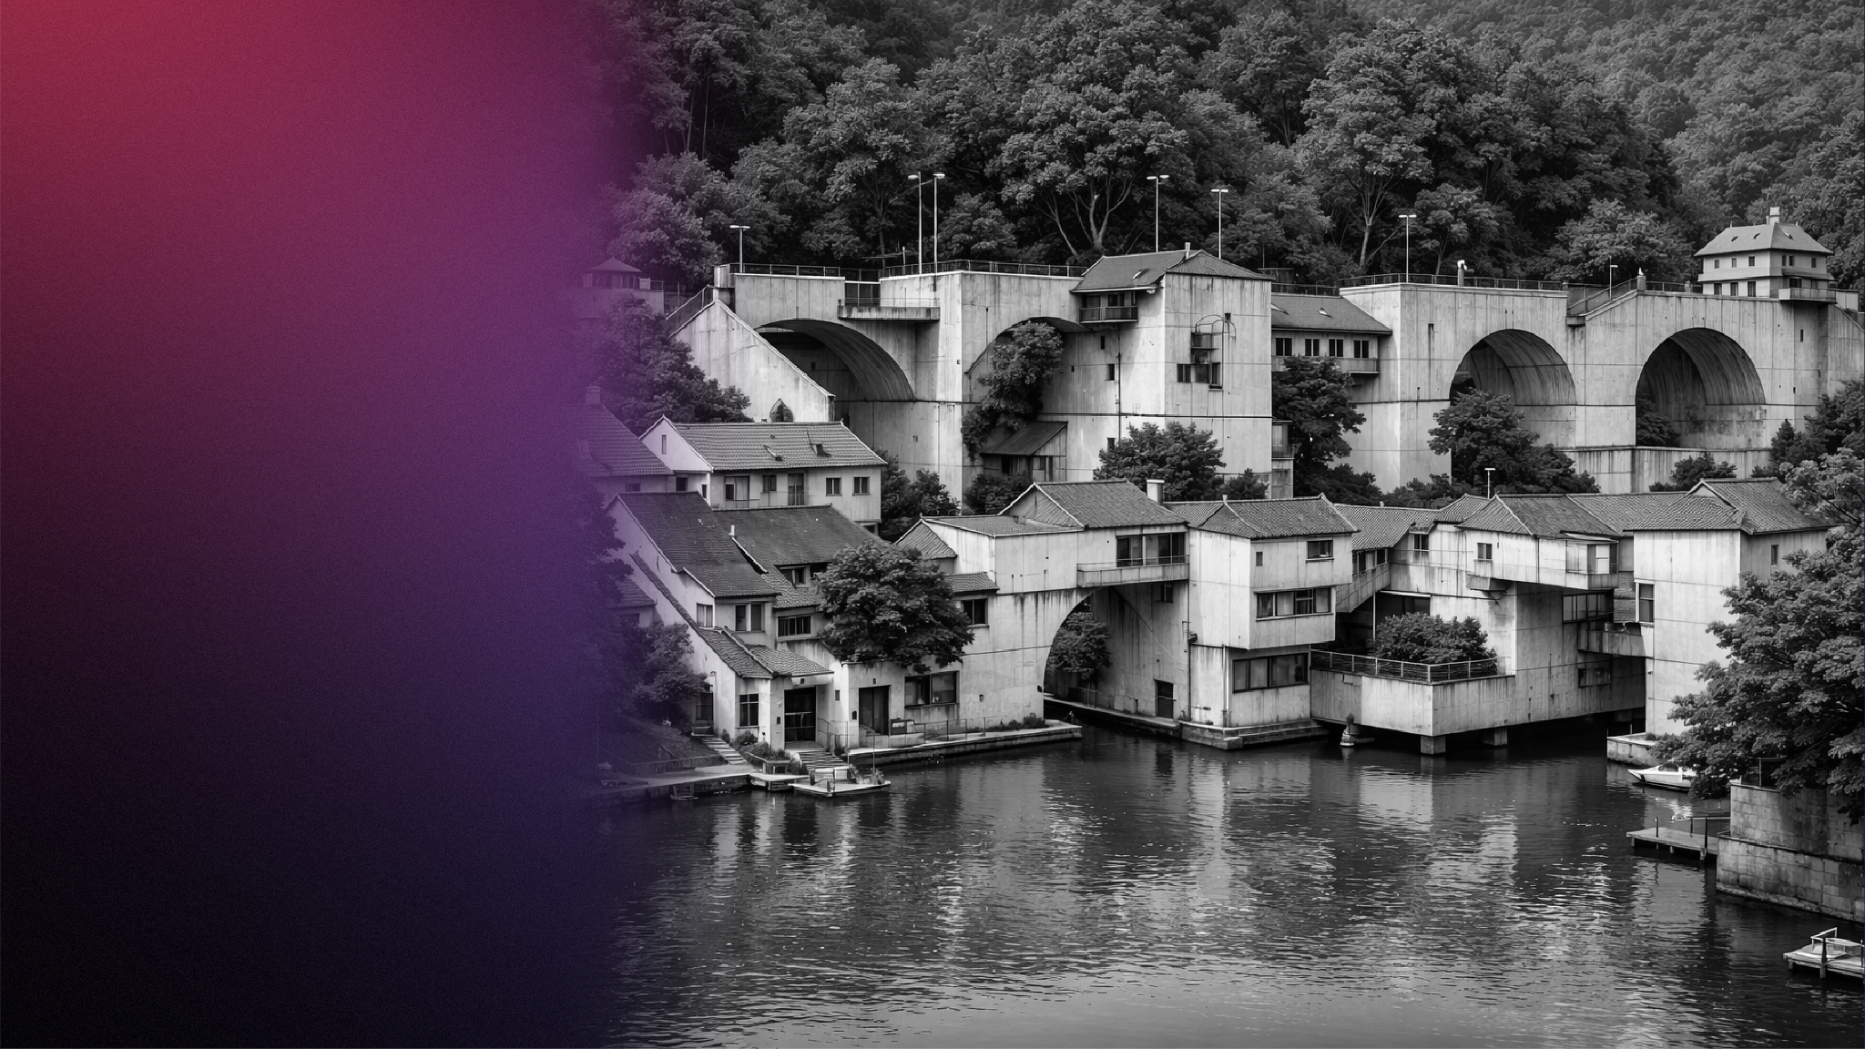
Highly scalable, high accuracy system

